Slide 1
Drone Parts
Ishan Khandelwal
Deepanshu Rohilla

Slide 2
Number of parts in a drone
Drone Frame
Flight Controller
Brushless Motors
Electronic speed controller(esc)
Propellers
Radio Transmitter
Batteries
Landing gear
Gimbal

Slide 3
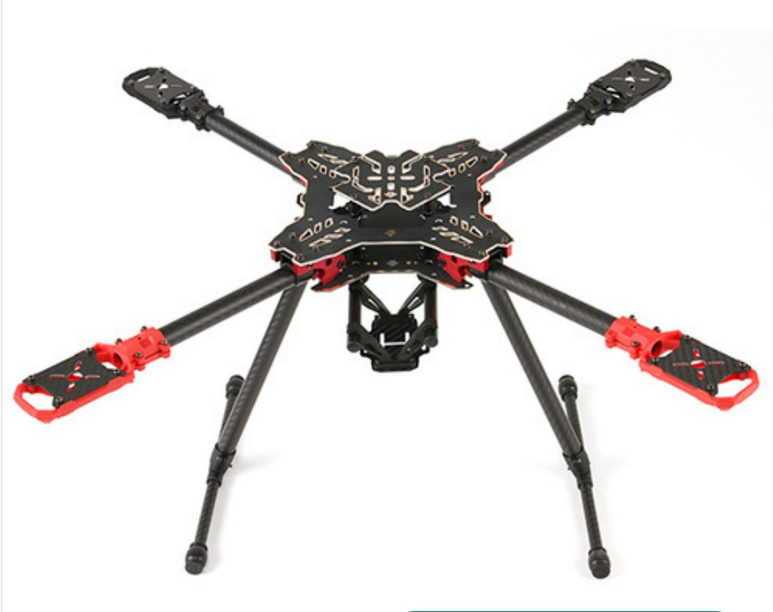
Drone Frame
The Frame of the drone acts as a skeleton for a drone. All the other components of the drone fit into it while distributing the center of gravity equally.

Slide 4
Drone Frame Market
Drone frames are made of carbon fiber reinforced composites, aluminium or light thermoplastics.
The manufacturing process involves welding, casting/moulding depending on the material being used.
Drones in corporate businesses are generally 250mm+ mostly imported from China.

Slide 5
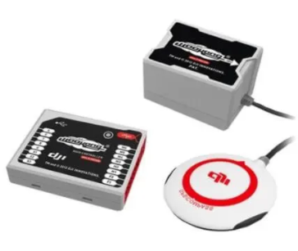
Flight Controller..
The flight controller interprets input from receiver, GPS module, battery monitor, IMU and other onboard sensors.
It regulates motor speeds, via ESCs, to provide steering, as well as triggering cameras or other payloads. It controls autopilot, waypoints, follow me, failsafe and many other autonomous functions. The flight controller is central to the whole functioning of your UAV.

Slide 6
DJI (Da Jiang Innovations)(China) is the biggest exporter for flight controllers right now and make very sophisticated systems. They also manufacture all components of a drone as well as finished drones and hold a 70%-80% share in the drone market.

Slide 7
Flight Controller..
FC’s for hobbyists/builders – Easy to install and perfect for people that do not want to spend large amounts of money from the get-go. Manufacturers- (pixhawk)Robocraft Impex
FC’s for filming –more focussed on creating fluent shots and accessible handling for a pilot. Within this segment, Chinese company Dà-Jiāng Innovations (better known as DJI) is a household name.
Commercial FC’s – most advanced drones, capable of safe flying and transporting high-value cargo. The biggest players are DJI and Pixhawk,
but new flight controllers like Auterion’s Skynode and Fusion Engineering’s Fusion Reflex are also promising flight controllers in the industry.
Indian manufacturers –
Navstik Labs, backed by Reliance Industries, has its own flight controller.
Mumbai-based IdeaForge
Robocraft Impex
Asteria, started up in 2012

Slide 8
Board | Affordability ($) | Weight (grams) | Open Source | FPV(first-person-view) Racing | Autonomous | Linux | Typical Frame Size (mm) | Popularity | Processor
Naze32 | 30 | 6 | CleanFlight, BetaFlight | Yes | No | No | 250 | High | 32 Bit
OpenPilot CC3D Revolution | 50 | 9 | CleanFlight, BetaFlight, ArduPilot | Yes | Yes | No | 250 | High | 32 Bit
Pixhawk | 120 | 60 | ArduPilot, PX4 | No | Yes | No | 350+ | High | 32 Bit
Pixhawk Cube | 200 | 150 | ArduPilot, PX4 | No | Yes | No | 350+ | High | 32 Bit
Navio2 | 200 | 80 | ArduPilot, PX4 | No | Yes | Yes | 350+ | Medium | 64 Bit
Naza-M2 | 200 | ? | CLOSED SOURCE | No | Yes | No | 250+ | Medium | ?
Cleanflight- Open-Source flight controller software.multirotor aircraft and fixed-wing aircraft,it supports a variety for shapes and motor counts.
BetaFlight - is an evolution of Cleanflight. Good for fast speed
Ardupilot-most popular drone software and it can control a lot of different types of vehicles.good for beginners. GPL3 license
PX4- BSD 3-clause license.

Slide 9
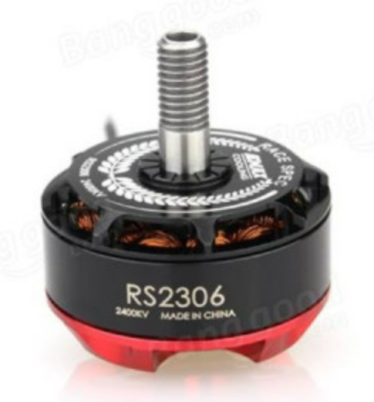
Brushless Motors
These are essential for the propellers rotation. Thus, they are helpful in controlling the direction and thrust force for propelling the drone. Brushless motors are 10% more efficient than brushed motors.

Slide 10
Brushless Motors Market
Brushless DC motors (BLDC motors) are used in a lot of electrical products
They are manufactured by a lot of different companies but most manufacturers buy BLDCs and BLACs from NIDEC Corporations, a Japanese manufacturer and distributor.
These are manufactured in India in Neemrana, Rajasthan.
Some Indian manufacturers include Spark Motors Pvt Ltd who have a production facility in China. Also, Sumit Engineering Works who are based in Gujarat.
Arrow Technologies, a Colorado based MNC also supplies BLDCs and BLACs in India.
Star automations is a big repair and maintenance company based in Pondicherry.

Slide 11
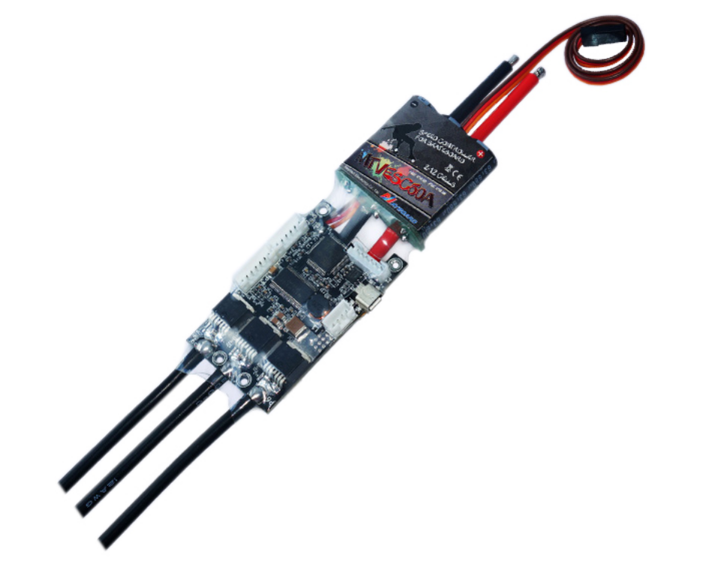
Electronic Speed Controller (ESC)
This is an electronic board that varies the motors speed. ESCs can also be used as a motor reversal or as a dynamic break.

Slide 12
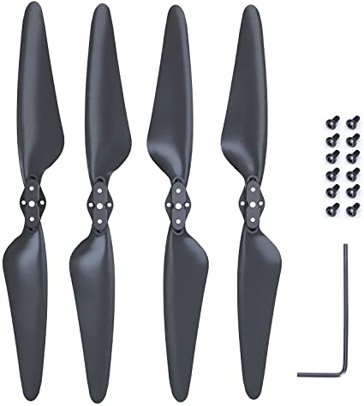
Propellers
Propellers are clove like blades structured to create a difference in air pressure. When in motion, they cut through the air creating difference in pressure between the top and bottom of the rotors. The top side is characterized by low pressure as compared to the bottom causing the drone to lift into the air.

Slide 13
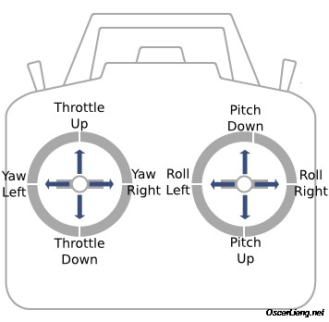
Radio Transmitter
A hand-held transmitter which controls and directs the drone. Consists of the throttle, yaw, pitch and roll. May also have controls for the camera and landing gear.

Slide 14
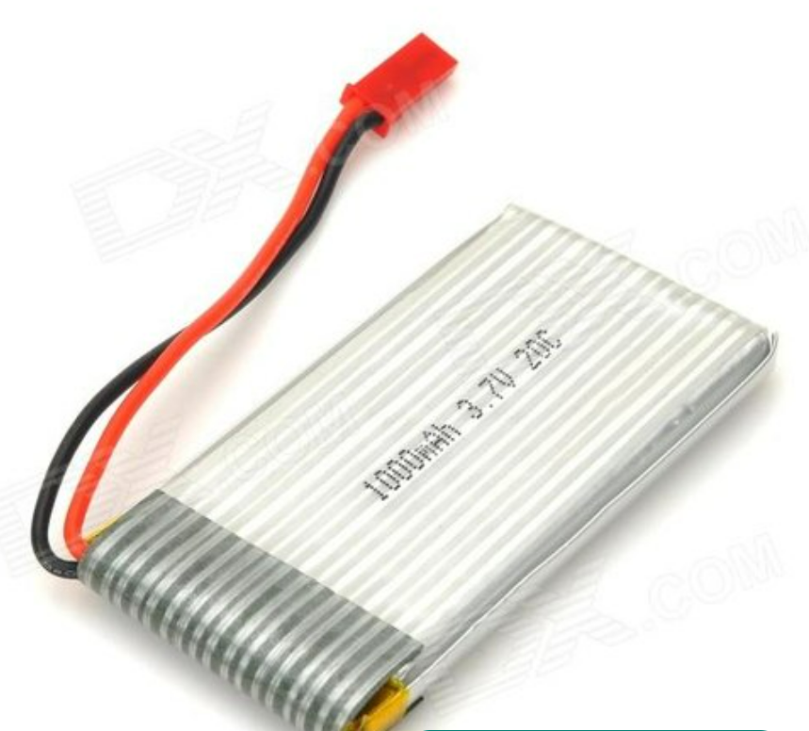
Batteries
These batteries are ‘intelligent’ meaning that they have over-charge protection, temperature data, charge cycle history, and communicate power output to the drone. This is to ensure the battery is safe to use repeatedly and so that there are no problems during flight.

Slide 15
More about batteries
Lithium Polymer (LiPo) are the most common types of batteries used in drones as they are light-weight and inexpensive.
Imported from China and assembled in India as lack of raw material. It is cheaper to import the batteries from China and assemble them here than importing Lithium.
13-16 Cells in a battery to provide approximately 40-48V with a capacity of 12,000-14,000 mAh
Major exporters of batteries to India include EaglePitcher Technolgies (USA), Shenzhen Grepow Battery Co. Ltd. (China), Plug Power Inc (USA) amongst others.

Slide 16
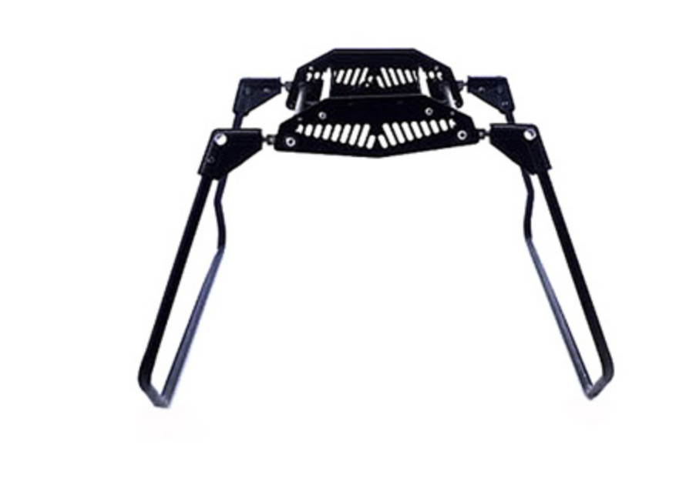
Landing Gear
This is a structure meant for safely landing the drone. However, it can be exempted since an experienced user is capable of balancing the motors speed for safe landing in emergencies. There are two major types of landing gear. One is fixed landing gear and the other is retractable landing gear.

Slide 17
Landing gear..
indigenously built by the Combat Vehicles Research and Development Establishment(CVRDE), a unit of the DRDO
India’s nascent drone industry is turning to 3D printing firms to ramp up production in the absence of adequate infrastructure
The moment things in the drone industry become more standardized, drone companies will switch to injection moulding (a manufacturing process where parts are produced by injecting molten materials into a mould) as that will be a cheaper option
Conventional manufacturing hinges on the size of the order, and most manufacturers do not have large volume needs right now
Manufacturers -Ideaforge

Slide 18
Where are drones being used currently
MILITARY ( UAV , ARMED QUADCOPTER)
DELIVERY(AMAZON PRIME AIR,GOOGLE WING ALPHABET)
AGRICULTURE(UAV, MAV, VTOL)
PHOTOGRAPHY (UAV)
RESCUE DRONES( SAR DRONES)

Slide 19
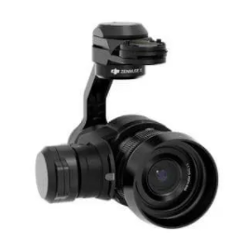
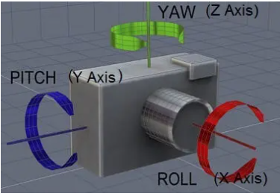
Gimbal..
The drone gimbal is the pivoting mount, which rotates about the x, y, and z axes to provide stabilization and pointing of cameras or other sensors.
A gimbal whether handheld or mounted on a drone is designed to give the camera operator the independence of photographing or filming without camera vibration or shake.
Tip: If you are having problem with jello effect, which is caused by vibration from the drone getting to the camera, then look at installing or changing the gimbal dampers. This can make a big difference.

Slide 20
Parts Of A Drone Gimbal..
2 or 3-Axis Drone Gimbal
3-axis gimbals provide better video stability than 2-axis gimbals. This is because 3-axis gimbals stabilize your video on all 3 axis (yaw, pitch and roll) while a 2-axis gimbal will stabilize only on the pitch and roll axis.
Damping Anti-Vibration Absorber
These units have the very important function of reducing or damping the medium to high vibration frequencies from the drone reaching the camera while still allowing low frequency actual board movement to take place in conjunction with the drone frame.
Drone Gimbal IMU
IMU (inertial measurement unit) is an electronic device which measures and reports a body’s specific force, angular rate and sometimes the magnetic field surrounding the body, using a combination of accelerometers and gyroscopes, sometimes also magnetometers.
The gimbal IMU uses programmed algorithms which create almost total stabilization and give effortless control to the operator.

Slide 21
Parts Of A Drone Gimbal..
Drone Gimbal Control Unit (GCU)
The Gimbal Control Unit also referred to as a GCU, is essentially a simple computer that takes data from the gyros and responds by telling the gimbal motors which way to move.
Cameras and Sensors
All the above mentioned parts are no good without the camera or sensor to capture the aerial photography, film or 3D imagery. The gimbal should come with the correct mounts, screws and cables to connect the camera to the gimbal and control unit.

Slide 22
Gimbals..
industry leaders such as DJI or Parrot who have their own line of drones and gimbals that were custom made for each model in order to maximise the quality of footage.
DJI - DJI develops and manufactures innovative drone and camera technology for commercial and recreational use.Headquartered in Shenzhen, widely considered China’s Silicon Valley.
Parrot - Parrot creates, develops, and markets advanced technology wireless products for consumers and professionals. headquartered in Paris
Indian companies
HC Robotics- Hyderabad-based company. It specializes in Unmanned Aerial Vehicles (UAVs), EOIR Cameras, Gimbals and AI-based image processing solutions.

Slide 23
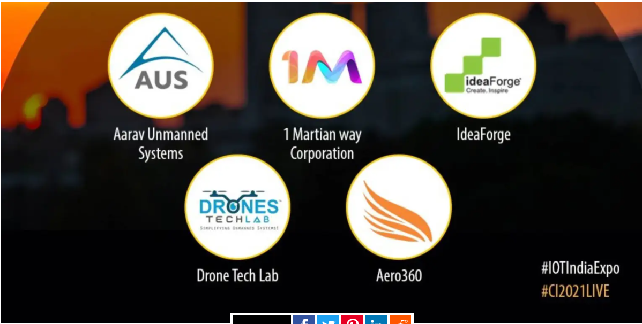
Government Initiatives..
There are approximately 200 drone startups in India. Nearly 90% of India’s drones are imported and most of them are imported from China. In order to localize the production of drones, the Government of India (GoI) liberalized its drone policy, introduced the ban on import of drones, and announced PLI (Production Linked Incentives) for drone manufacturers.
The hurdle:
Suppliers are reluctant to undertake low-volume production: drones are not within reach of general public due to the government regulations. Thus, the market demand for drones is low.Manufacturing in low-volume is not economical for supplier
The solution: On-demand manufacturing —
On-demand manufacturing is a manufacturing system wherein goods are produced only when the customer demands and in quantity required
It is a business ecosystem wherein the participants are customer, supplier, and on-demand manufacturing platform.The on-demand manufacturer pools orders from multiple customers and provides it to the supplier.The volume provided by the on-demand manufacturer is economical to the supplier

Slide 24
Operating Systems
RTOS is the standard norm (Real Time Operating System).
Phoenix RTOS is the most famous open-sourced OS.
TencentOS is the most famous OS used by big manufacturers, especially in China.
DJI uses Ubuntu. Apart from it, variation of linux called lynxOS is also used in some use cases.
As of now, there is no monopoly or duopoly in the drone OS space.

Slide 25
Specifications for an agricultural drone
DJI is a prime leader in manufacturing and selling agricultural drones.
https://www.dji.com/t20/specs
RattanIndia and DCM Shriram want to build manufacturing plants for end to end production of drones in versatile categories.
Garuda Aerospace

Slide 26
Sources
https://www.reddit.com/r/diydrones/comments/qhug2a/difference_between_px4_vs_ardupilot_and_mission/
https://en.wikipedia.org/wiki/Autonomous_aircraft#:~:text=February%202022),intervention%20from%20a%20human%20pilot.

